Slide 1
Biometric Credit Card
Ellen, Emma, Ida, Johannes, Mathias & Thomas

Slide 2
Table of Contents
Short Intro
Production/Idea/Campaign
Know How
Customer/Users/Target Group
Market
Competitors
Economy
SWOT Analysis
Future/International Perspectives

Slide 3
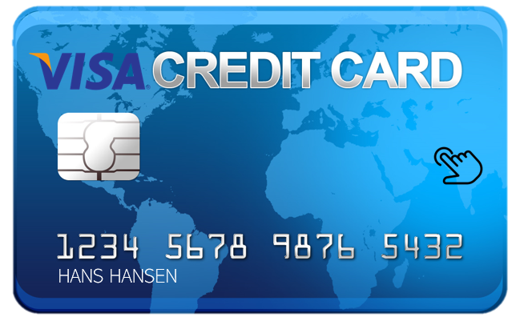
Short Intro
Biometric Credit Card
Safety
Latest and newest technology
Fingerprint

Slide 5
Parameter Mix – The Four P’s
Product
Promotion
Place
Price

Slide 6
Know How
NETS (Northern European Transaction Services)
Hard to get in contact
Hope for further development
An possible invention
Useful invention in the near future

Slide 7
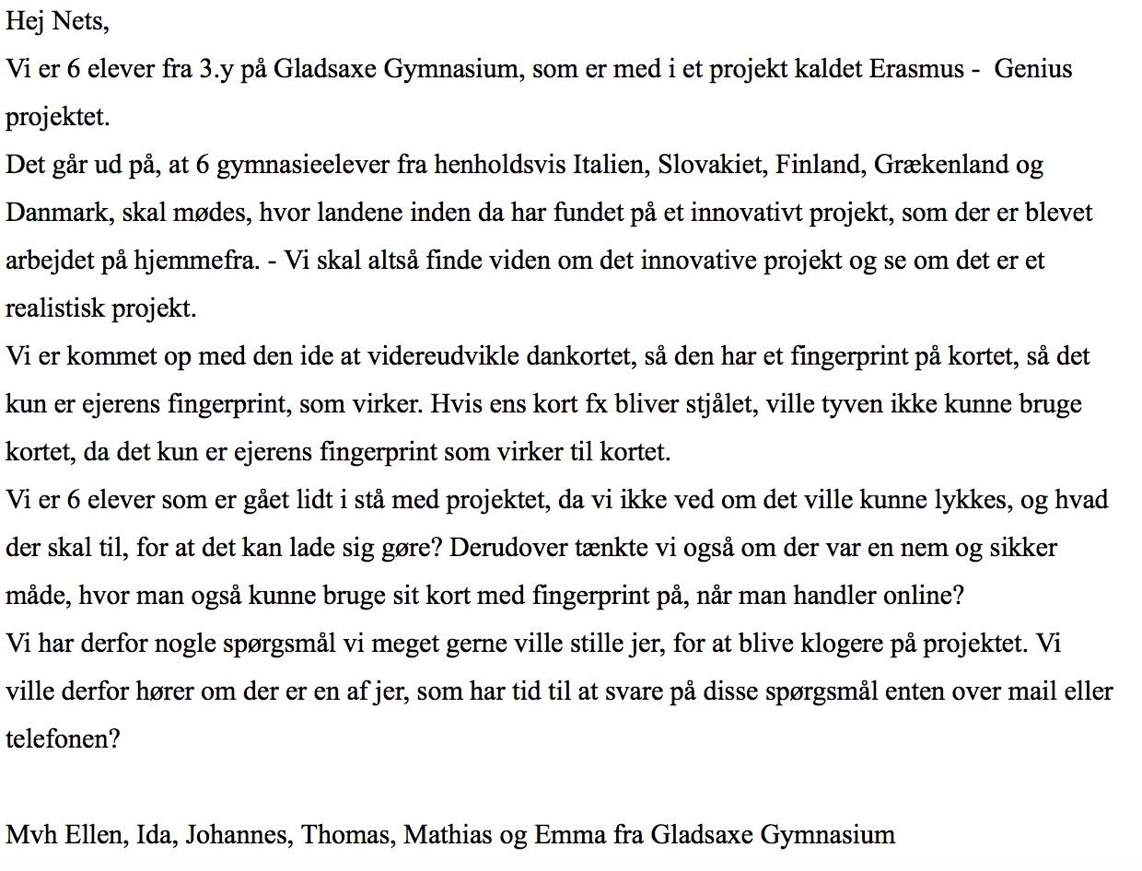
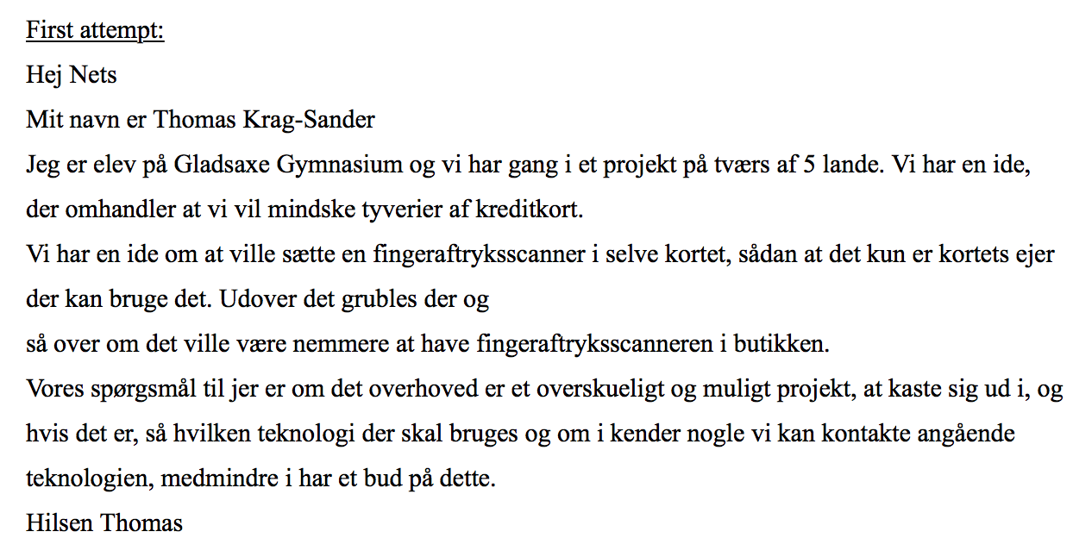
Our attempts to reach out to NETS

Slide 8
Customers/Users/Target Group
People above 16 years old
Posting commercials
Will create interest curiosity

Slide 9
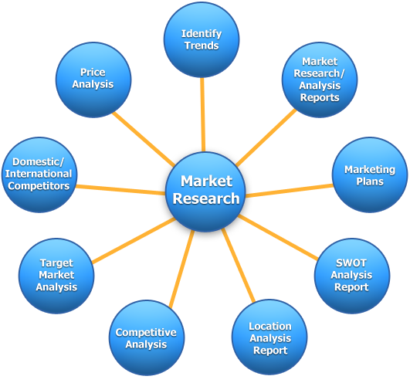
Market
Need for our product
Afraid of having their card stolen
Searching for alternatives
Exploit to our advantages

Slide 10
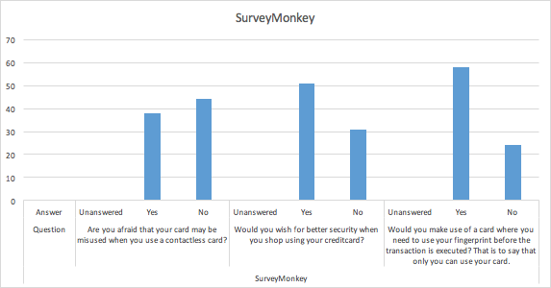
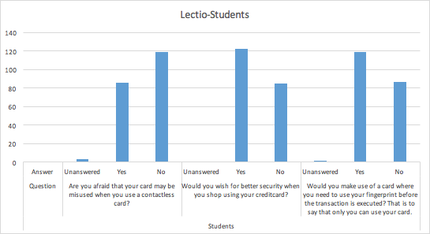
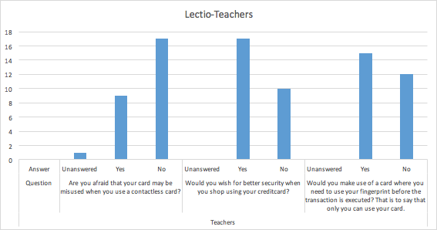
Questionnaires

Slide 11
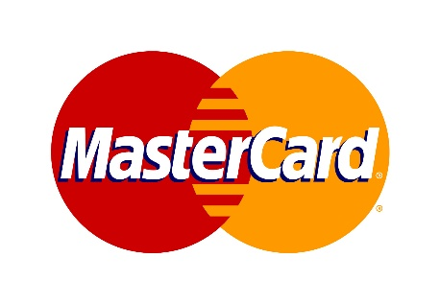
Competitors
Other Credit card companies
Develop a new and better product
Same invention
Utterly different and unique thinking
Creation of a new level of market and client segment
Equally competing
Public commercials

Slide 12
Economy
Banks
Credit card companies
Other companies

Slide 13
SWOT Analysis
Strenghts:
Weaknesses:
Internal
Safety
Unique way
Any new technologies
Fraud
Banks
Good brand/image
Oppertunities:
Expanding
A worldwide safety system
Improves the clientele
Dysfunctional people
Economy
Threats:
System failure
New competitors and existing companies
External

Slide 14
Future/international Perspectives
Safety when shopping online
The system

