Slide 1
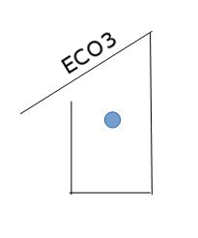
Eco3
Matilda, Hanna, Ida, Fanny, Jenny and Cecilia

Slide 2
Our company ECO3
We are a company selling handmade, organic, environmental friendly and high quality wooden products online
Main values: high quality and ecological tree products
Every product is made with a lot of love

Slide 3
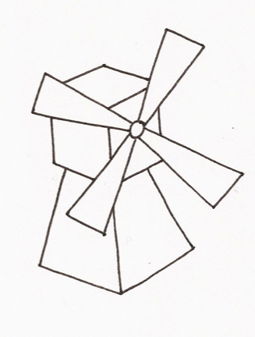
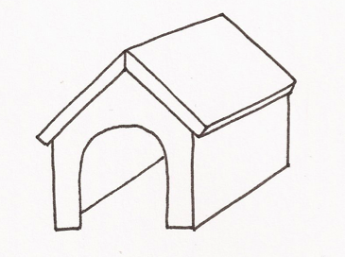
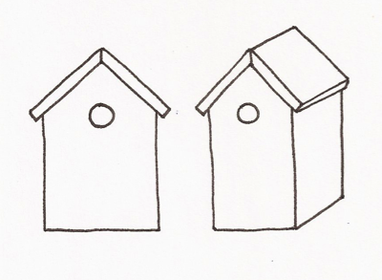
Some of our products
A birdhouse, doghouse and a windmill

Slide 4
General
Targets: private house owners, other kinds of houses with a yard
Products designed for outdoor use
We have a website on the Internet, where you have the opportunity to design your own product
Knowledgeable staff who are all specialized in different fields
By purchasing our products you support young Finnish entrepreneurship
A percent of our income also goes to charity

Slide 5
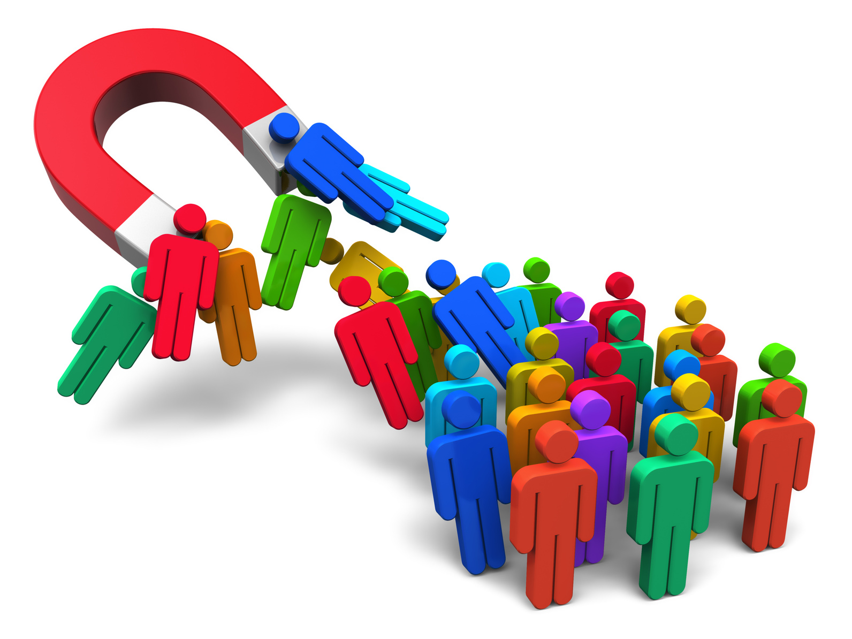
Marketing
We hand out free copies of our products to famous people, for example to YouTubers
Ads on Facebook and other social medias
Articles and ads in interior decorating and gardening magazines
Different kinds of offers:
- free shipping in the purchase of a specific amount of money
- choosing of a product made by a particular manufacturer
- getting a particular product for free with the purchase of a certain amount of money

Slide 6
Sustainability
Our products have a good quality and they will last many years
Eco-friendly products are better for the environment
Wooden products are more sustainable than for instance plastic
We don't use fossil fuels to make our products
70% of the Finnish area is covered with forest

Slide 7
Economy

Slide 8
SWOT
Strengths The customer can design their own product Good marketing and special knowledge in web trade and design Creative and young entrepreneurs full of ideas Helpful custom service, skilled in languages Ecological and locally produced Made by Finnish tradition and design Accessible 24/7 Fast delivery, we are able to say exactly how long it will take for the product to be delivered | Threats Competition Cheap and mass-producing companies
Opportunities Custom service through a chat on the front-page during a limited time Possibility to employ immigrants for seasonal work To use only ecological material International and modern | Weaknesses Rather expensive products Eco3 isn´t established on the market yet New company We only sell our products online

Slide 9
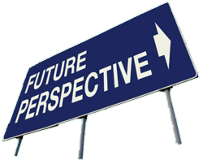
Future/international perspectives
Employing immigrants (seasonal work)
Expand our website in even more languages
Chat room in the website where customers can ask for help
Being a role model to other companies
We will start selling products in stores all around the world
e
s

Slide 10
Our company in a nutshell
ECOLOGICAL
HANDMADE
GREAT QUALITY PRODUCTS
FAST DELIVERY
THE POSSIBILTY TO DESIGN YOUR OWN PRODUCT
BY BUYING A PRODUCT YOU SUPPORT US :-)

