Slide 1
STUDENT CENTER
Slovak Group

Slide 2
Intro
a room for students
develop cultural spirit
relax, meeting friends

Slide 3
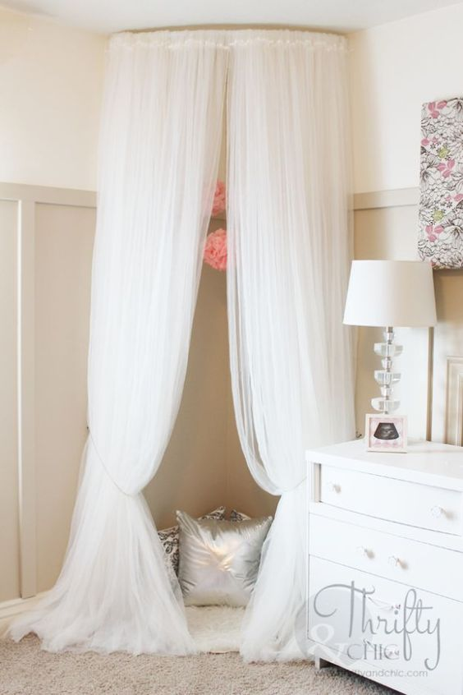
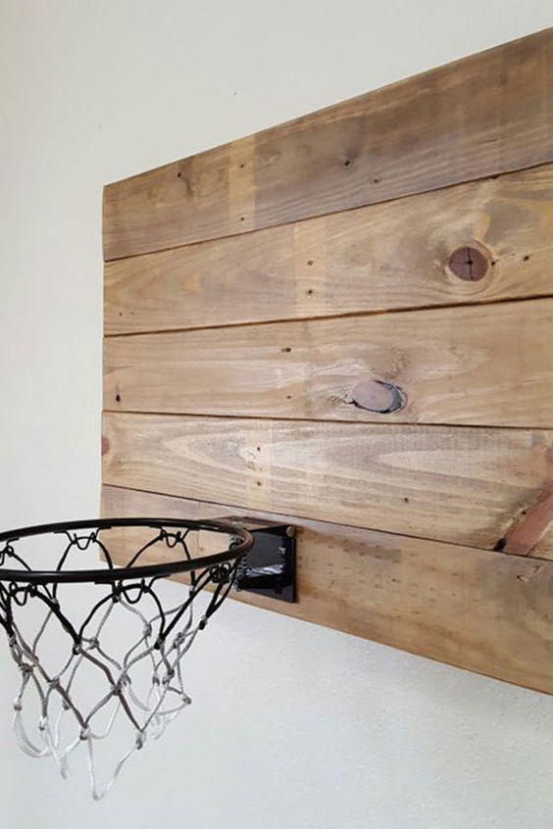
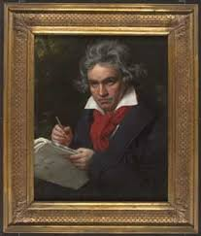
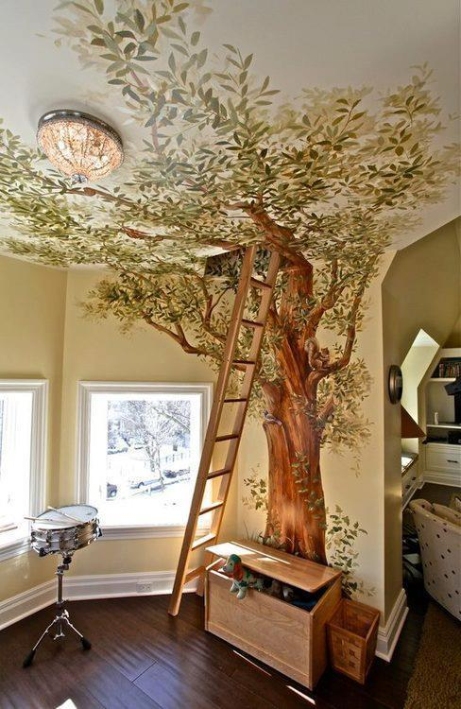
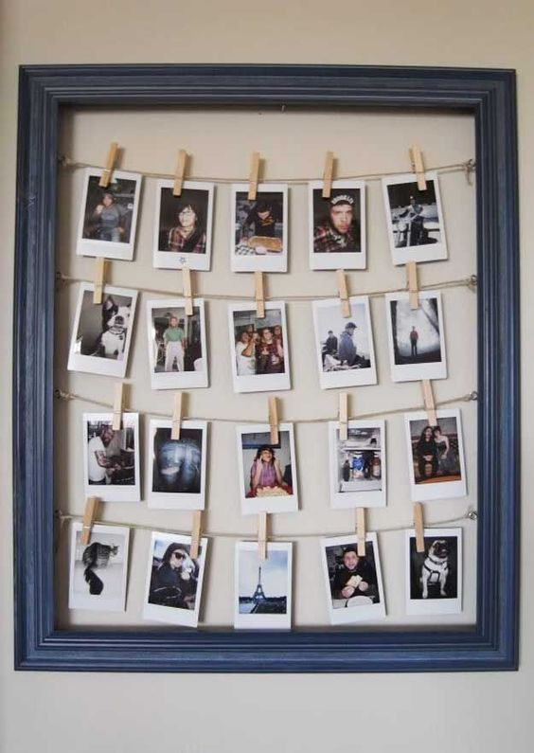
Our project - The student center
The room full of art
Portraits of famous people
Quotations of famous people

Slide 4
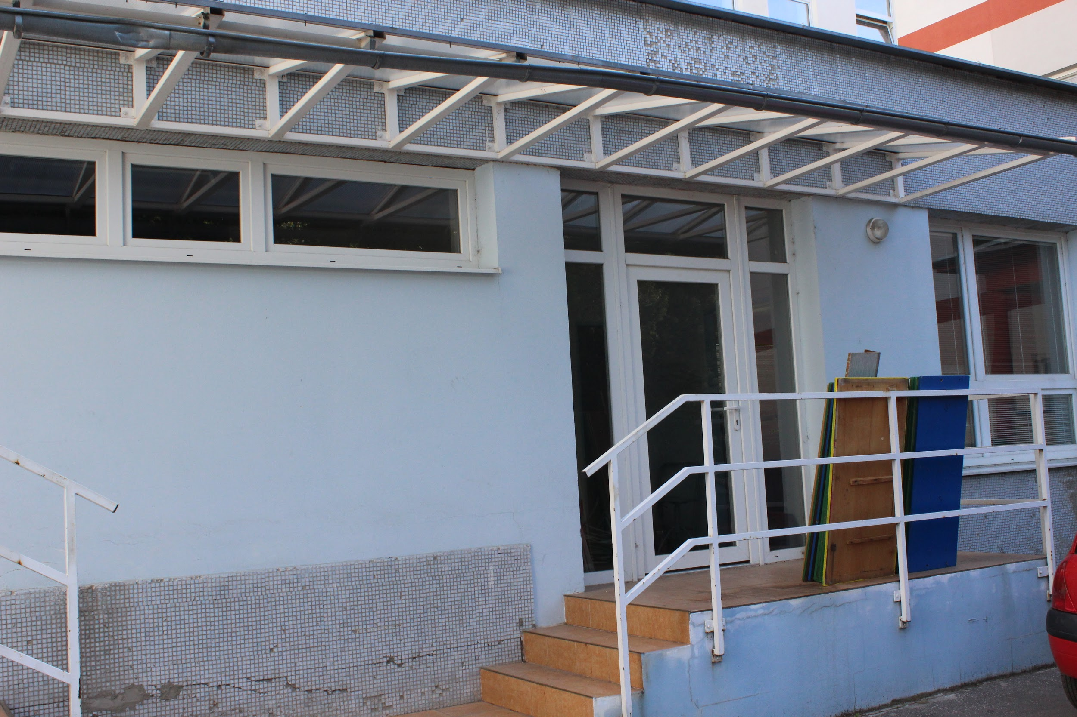
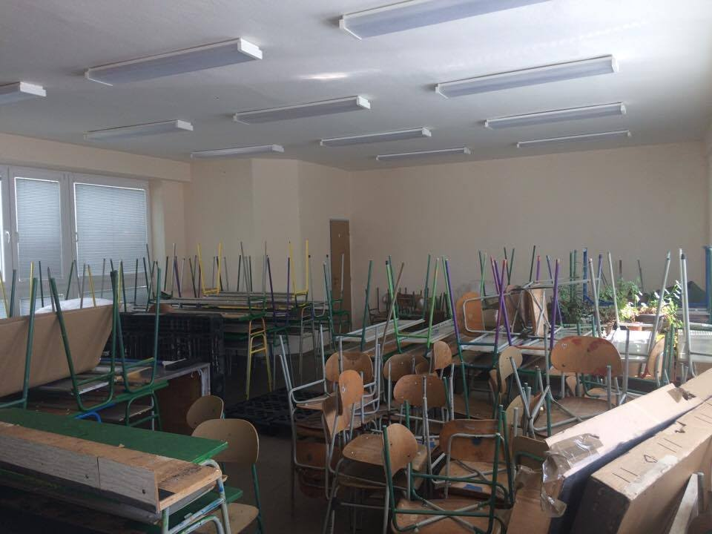

Slide 5
Who will use our room?
Lack of places like this in our town
Primarily students of Gymnazium Myjava, alternatively other young people living in Myjava
Everyone, who is interest in art, culture…
Market
Filling a market niche in Myjava
Free using by home students of Gymnazium Myjava
Paying some rent by young people from other schools

Slide 6
SWOT analysis
Strengths | Weaknesses | Threats | Opportunities
Our work | Not located exactly in school building | May be problem with sponsors | Useful for many different age groups
New place for debates and concerts | Location in our town | Lack of interest between students | Culture
Educational and free
Accessible for everyone

Slide 7
Sustainability
Interest in arts and culture is decreasing
Show young people how the art and culture is beautiful
In the future, we will try to gain some more students to take care about this place in order to keep it running
Piece of art in every corner

Slide 8
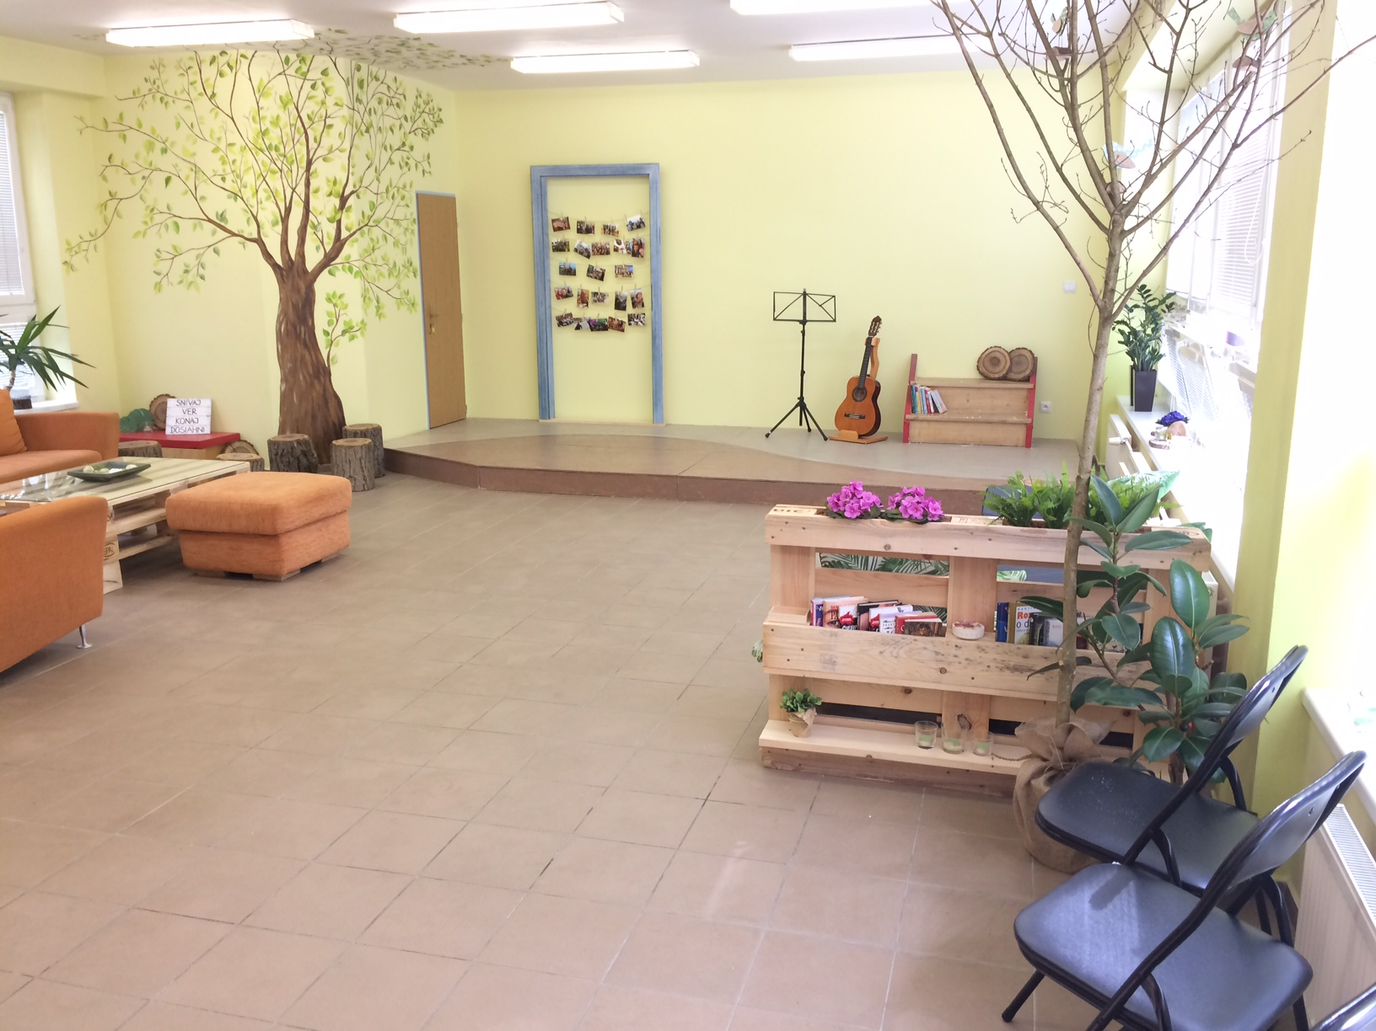

Slide 9
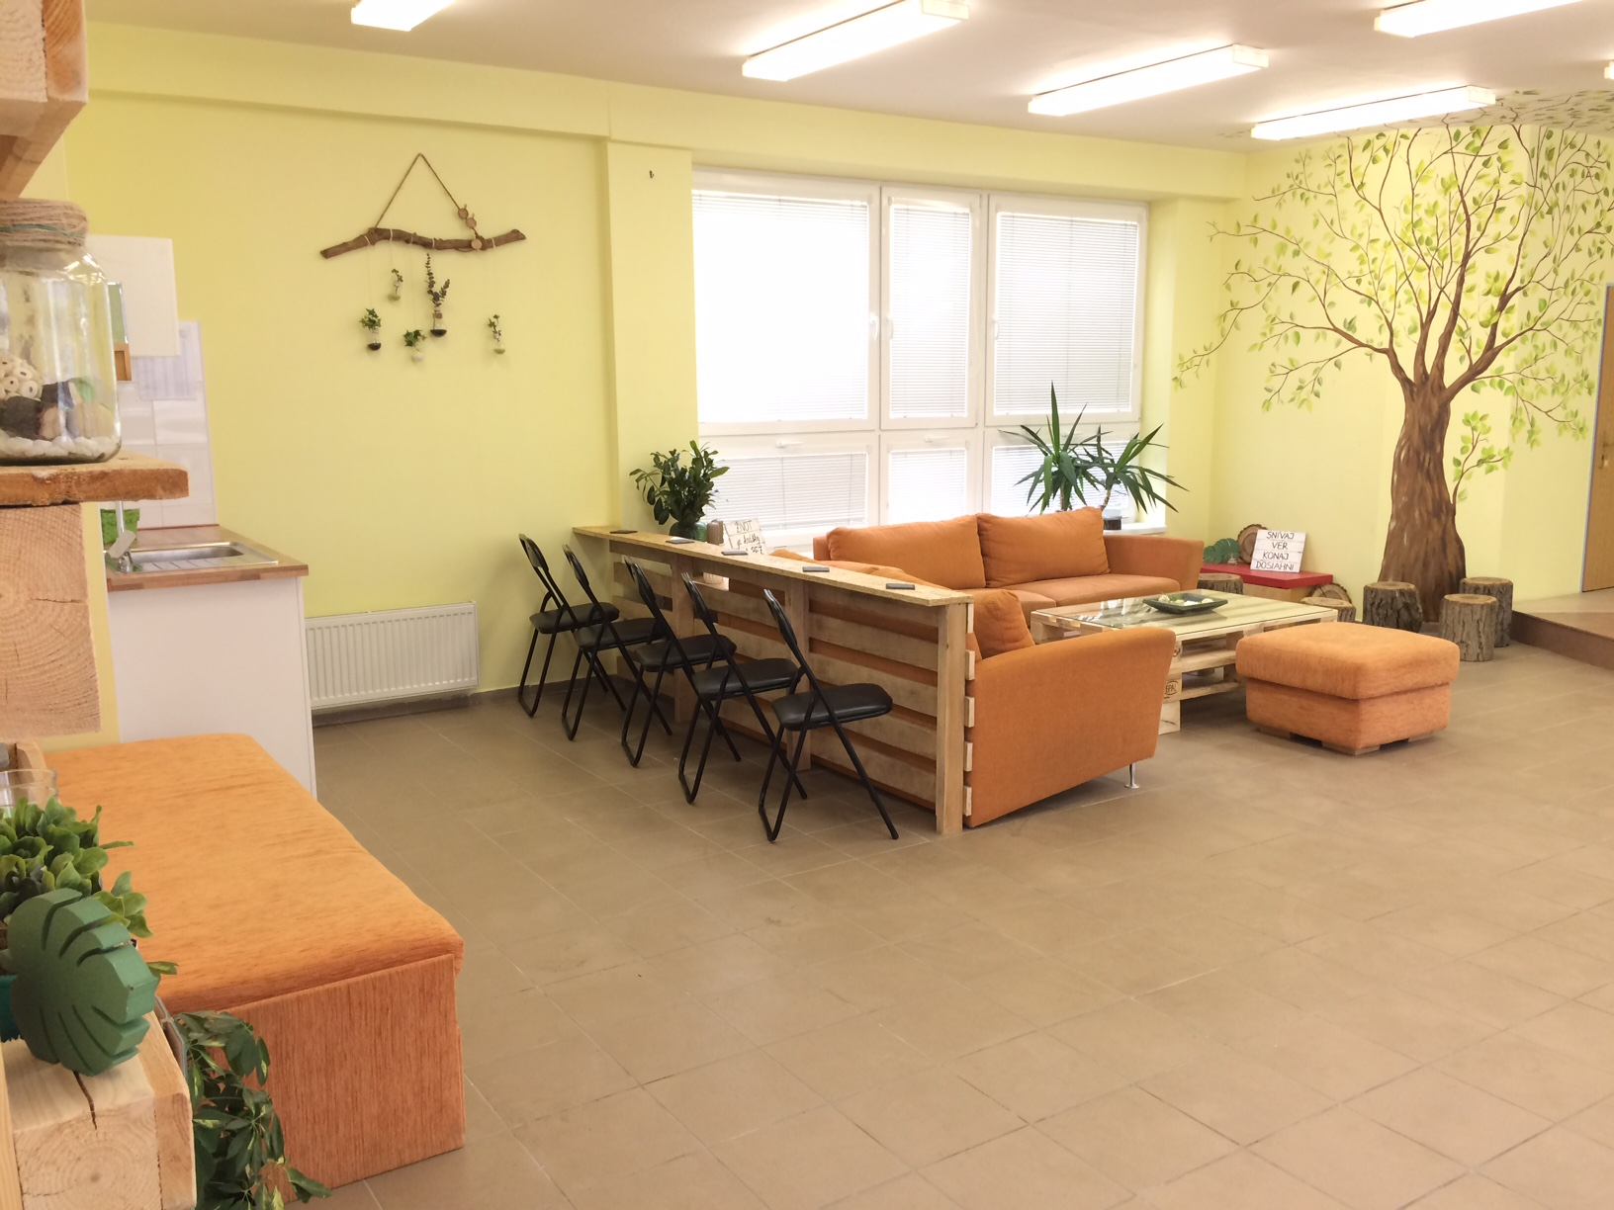

Slide 10
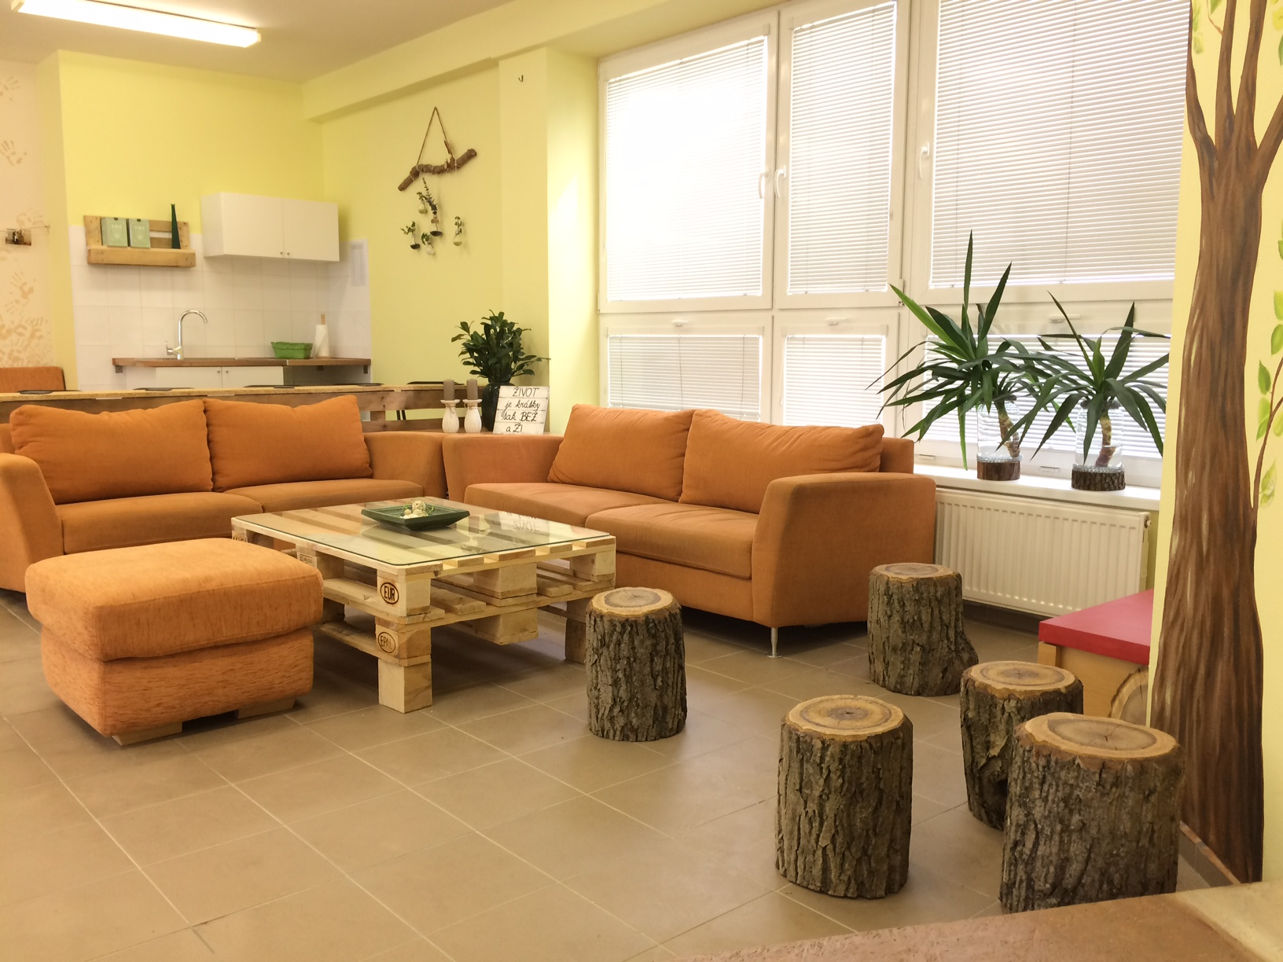

Slide 11
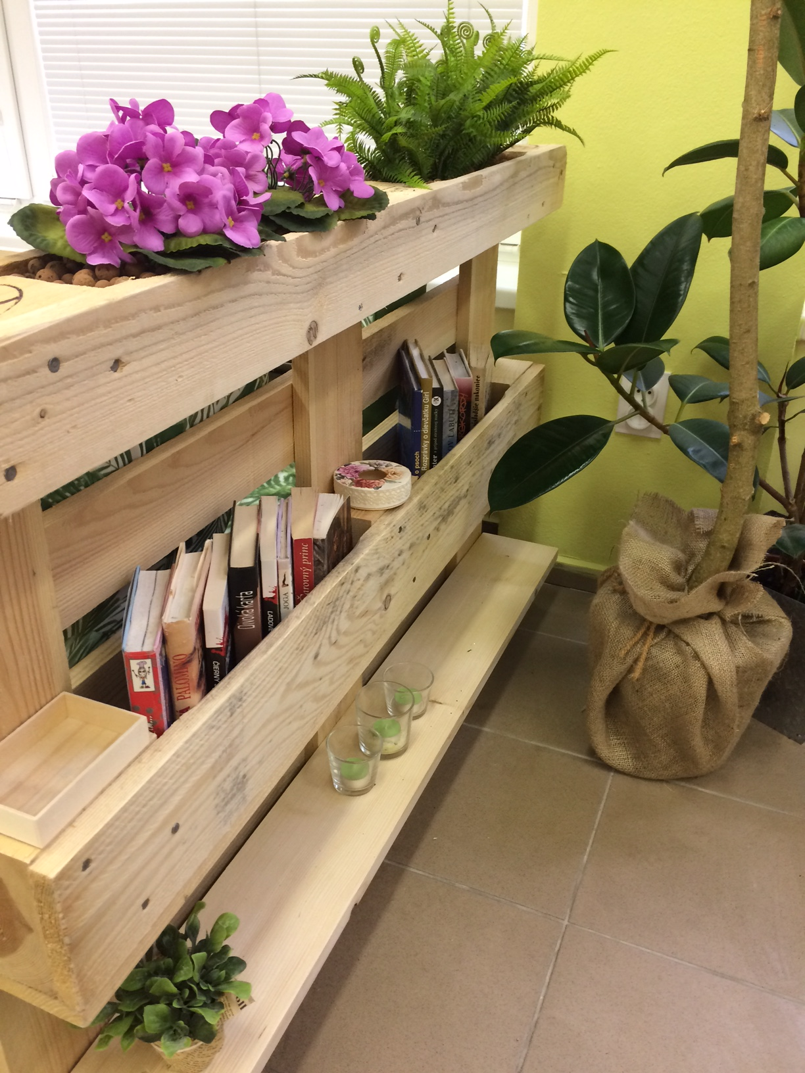
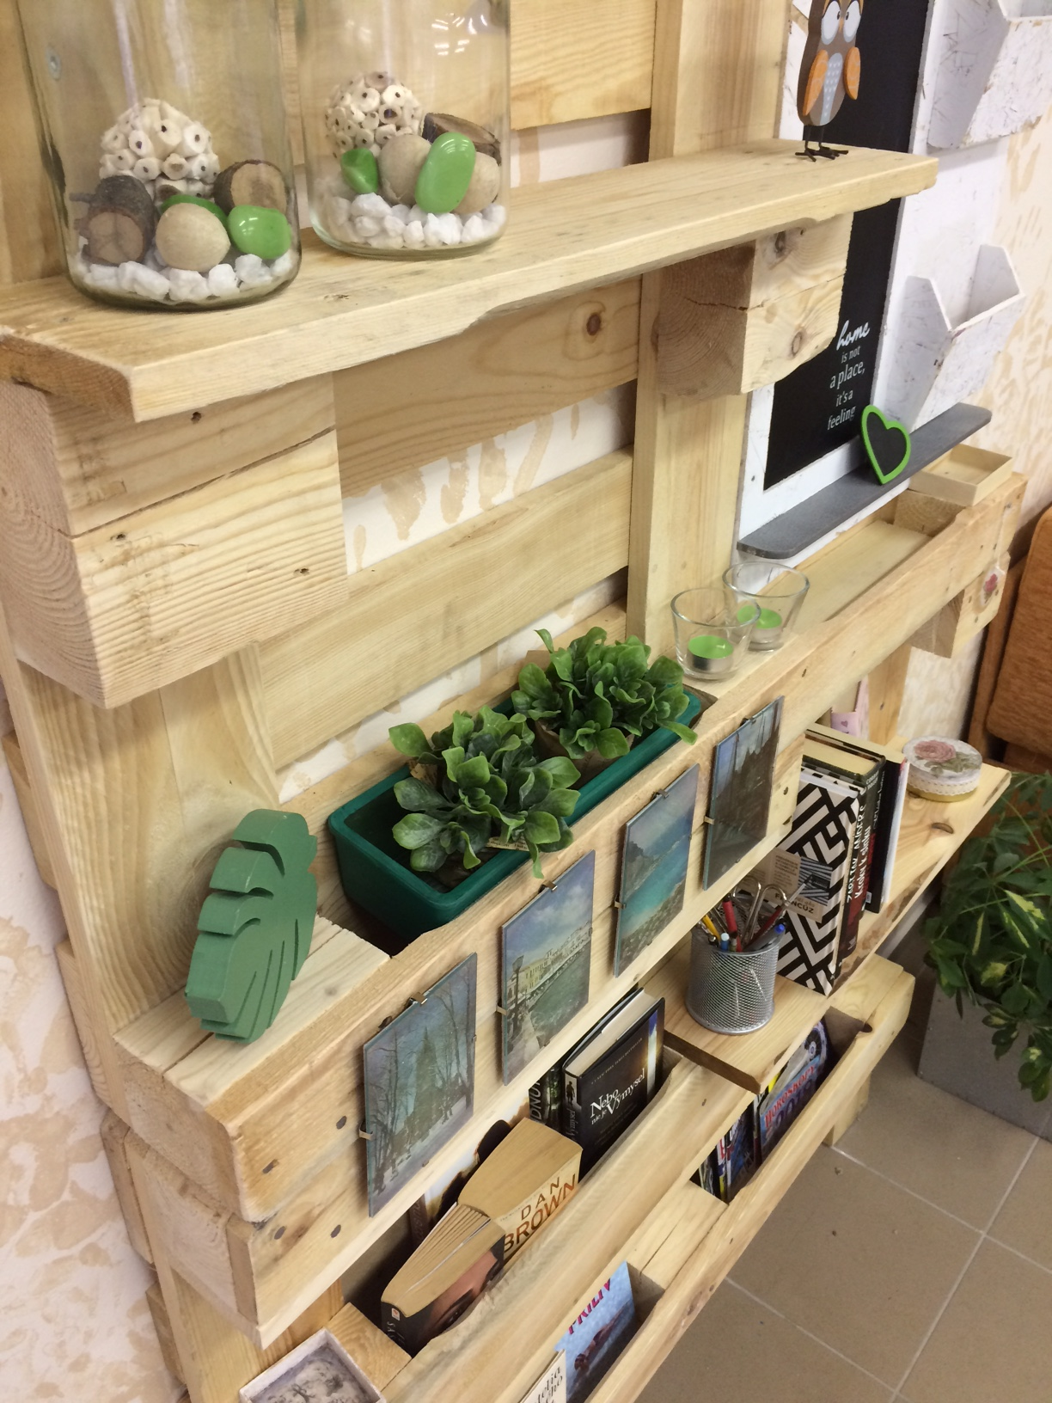

Slide 12
Thank you for your attention!

